Slide 1
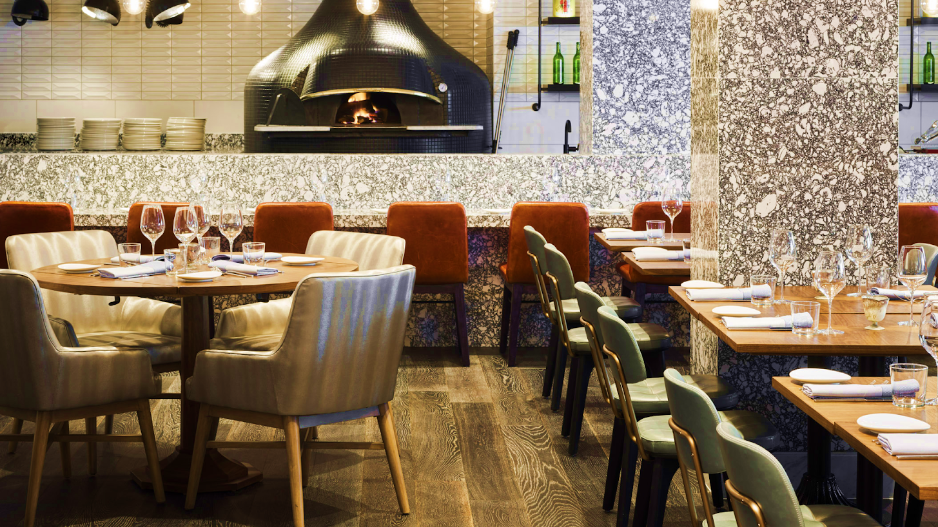
Caribbean cuisine Restaurant
Rayner Mendez
CST 3504

Slide 2
Business Description
Caribbean Cuisine Restaurant is a food service business that serves a variety of Caribbean food. Because the business is growing, my client will need a system capable of tracking customers, orders, inventory, employees, locations, deliveries, offers, discounts, profit, and receipts.

Slide 3
Goals
Plan the execution of the database according to the business requirements.
Analyze the business requirements gathered from the client.
Develop the logical design of the database.
Develop the physical design of the database.
Implement the physical design and create a production-ready database.

Slide 4
Tables Description
Customer Table: represents a customer location customer or a delivery customer.
Orders Table: Keeps track of the online and on-site orders made.
Order Item Table: Keeps track of the items used to create the order.
Discount Table: Used to create discount codes which later will be used in combination with the order table.
Delivery Table: Contains information about every online order that has been delivered.
Inventory Table: Keeps track of the items the location has
Recipe Table: Keeps track of the recipes used in every order.
Location Table: Represent the employee’s location and the inventory location.
Employee Table: Holds the information of every employee based on its location.
Address Table: Holds the address of the credit card table, location table, employee table, and delivery table.
Credit Card Table: Represents the payment method when the customer

Slide 5

Database Diagrams
Logical and Relational Diagrams

Slide 6
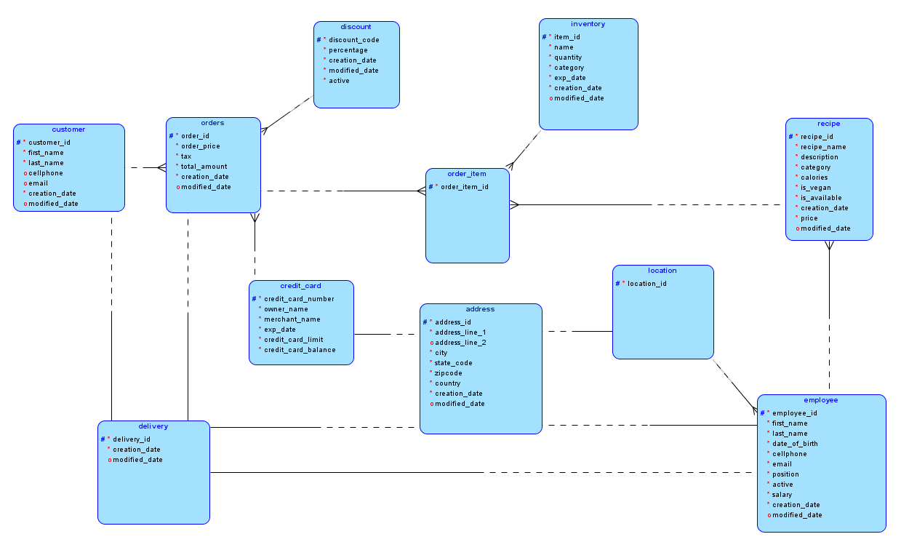

Slide 7
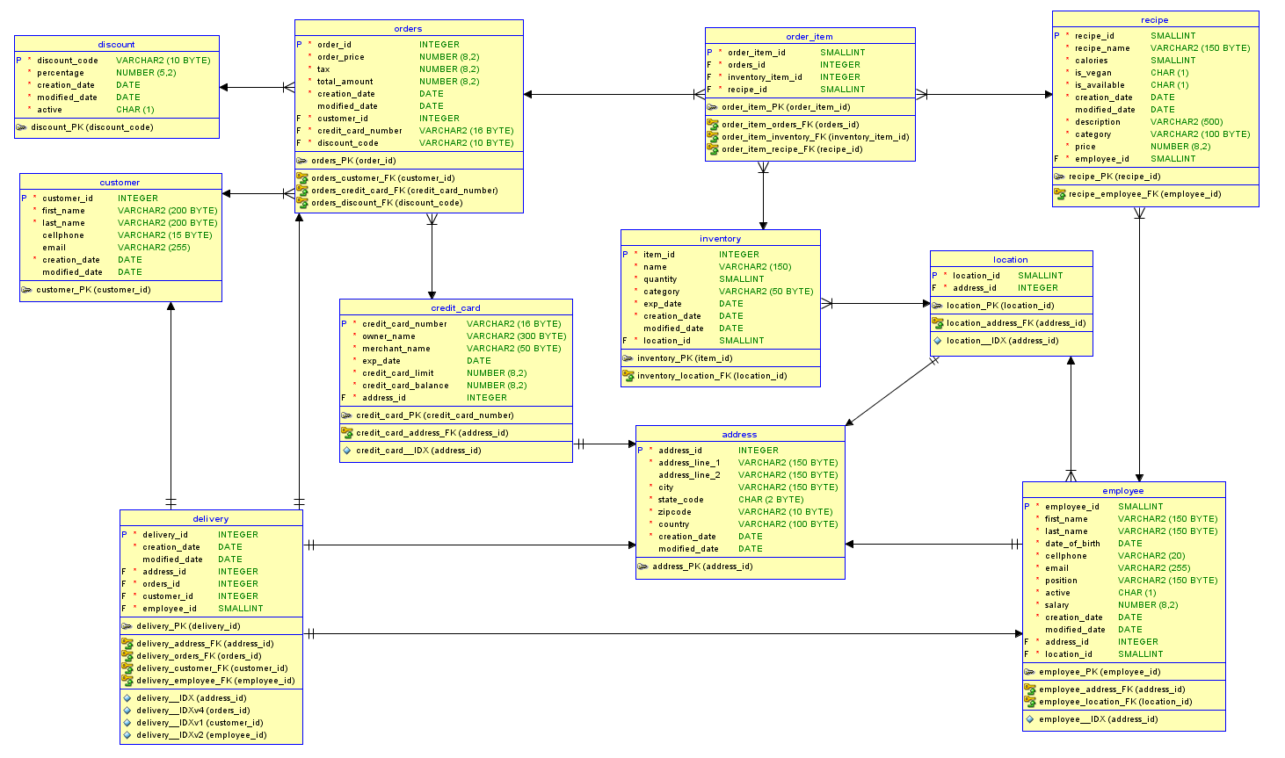

Slide 8
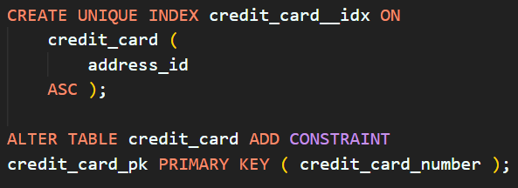
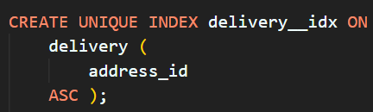
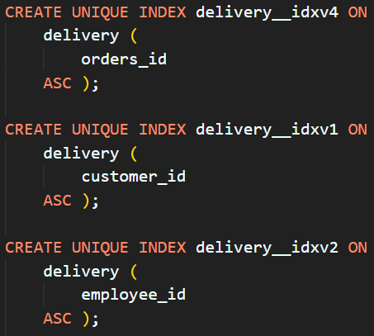
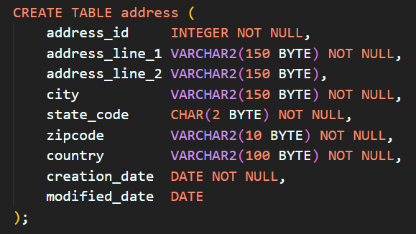
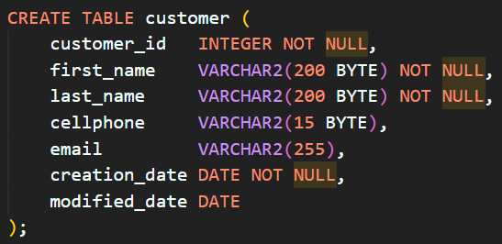
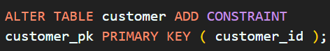
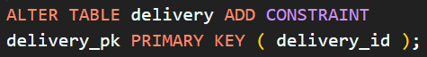
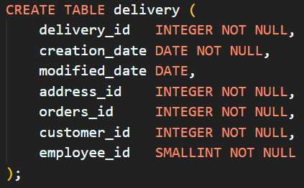
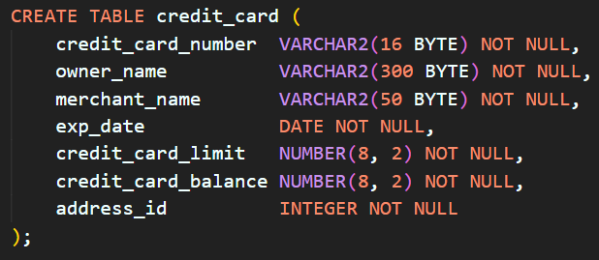
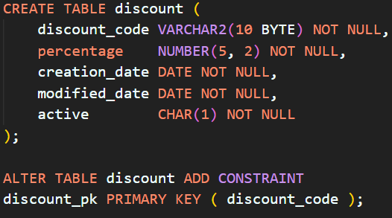
Implementation

Slide 9
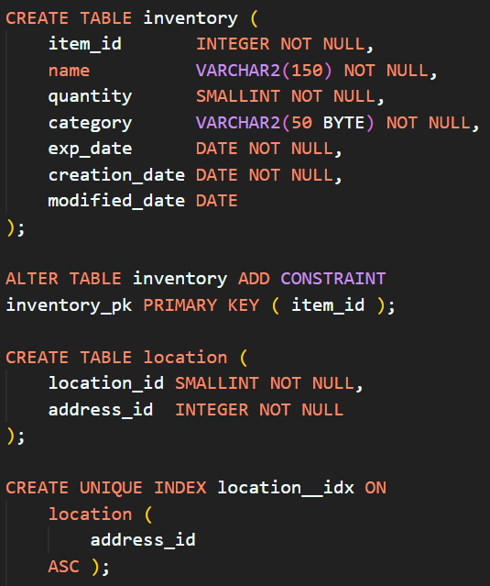
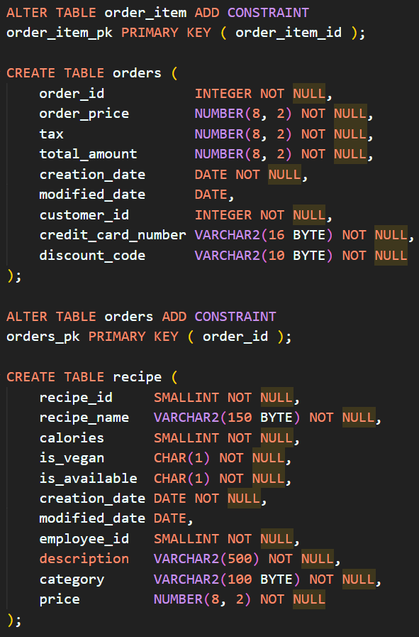
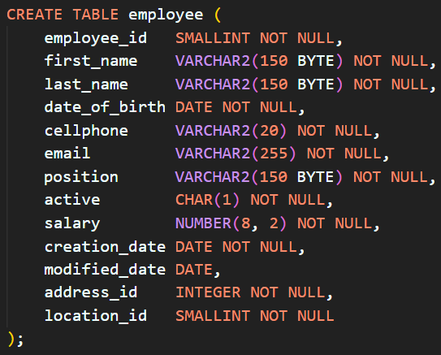
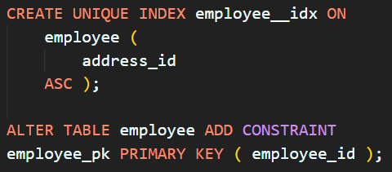
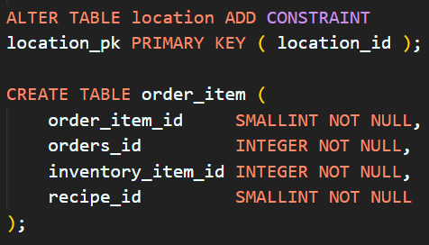
Implementation - 2

Slide 10
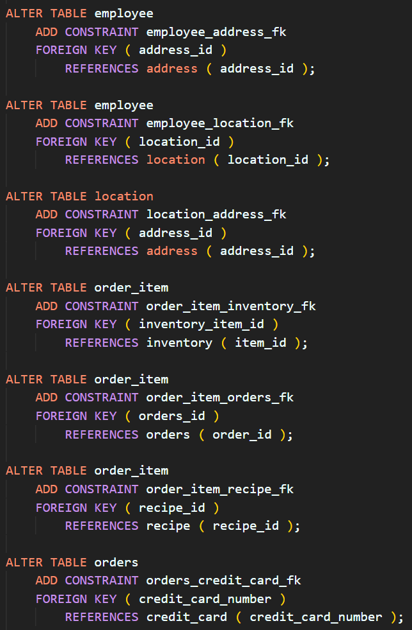
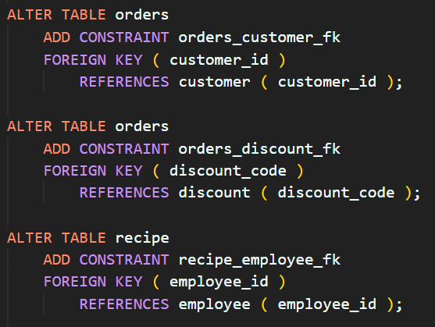
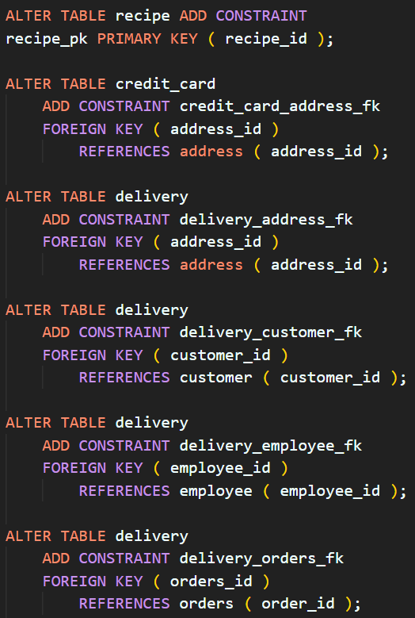


Implementation - 3
Click on the icon to open the script.sql file

Slide 11
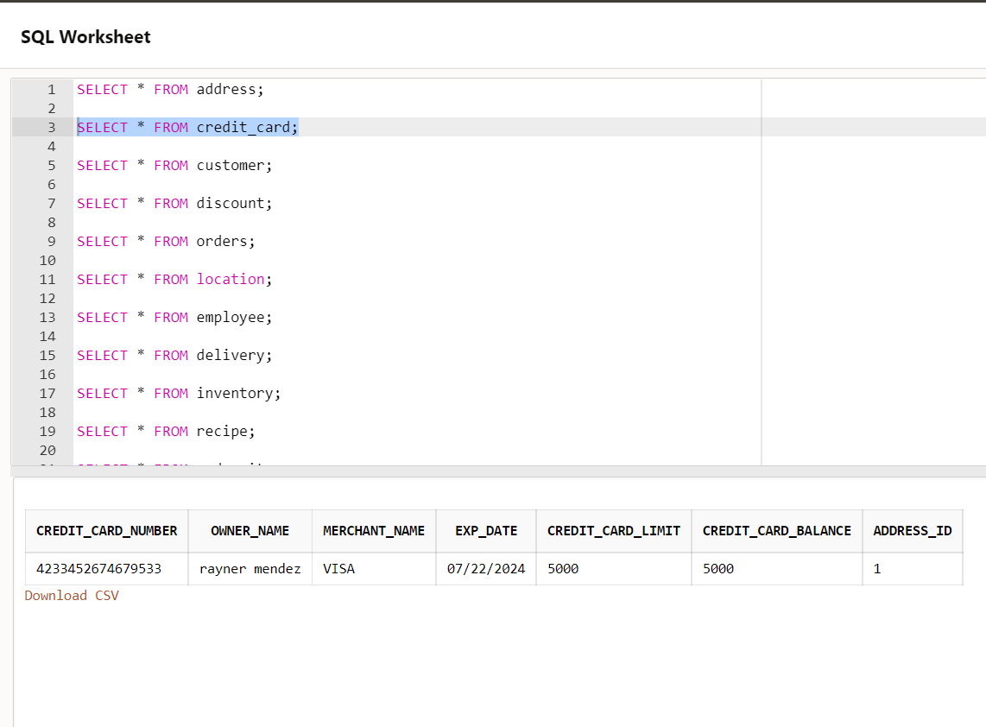
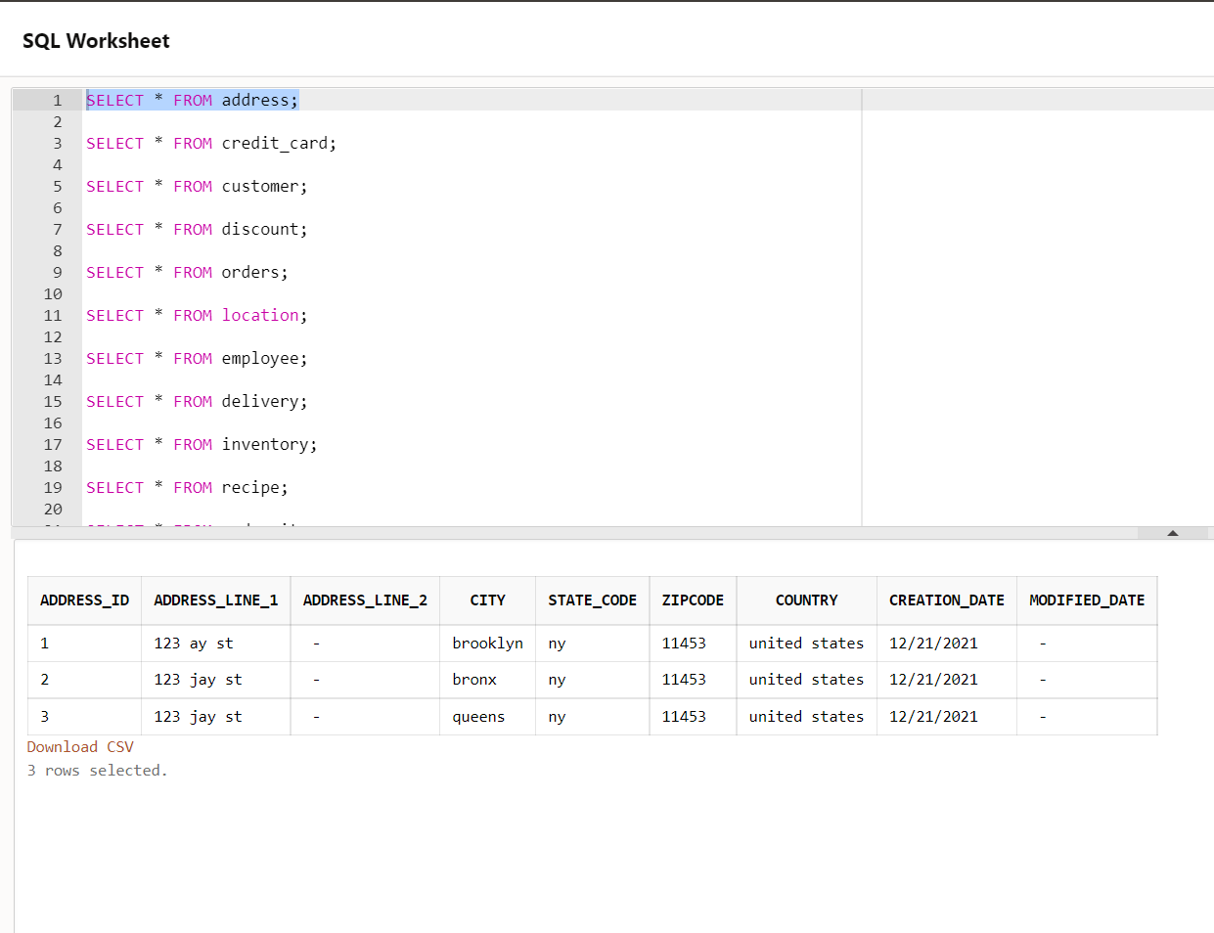
Testing

Slide 12
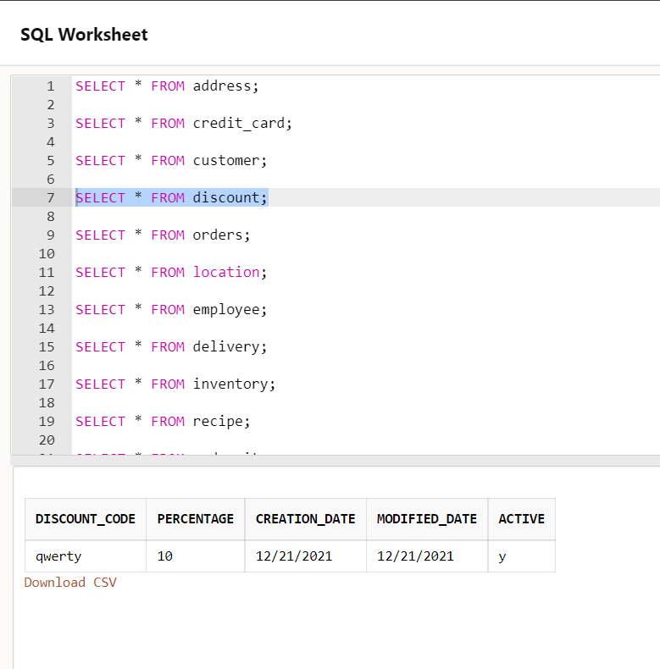
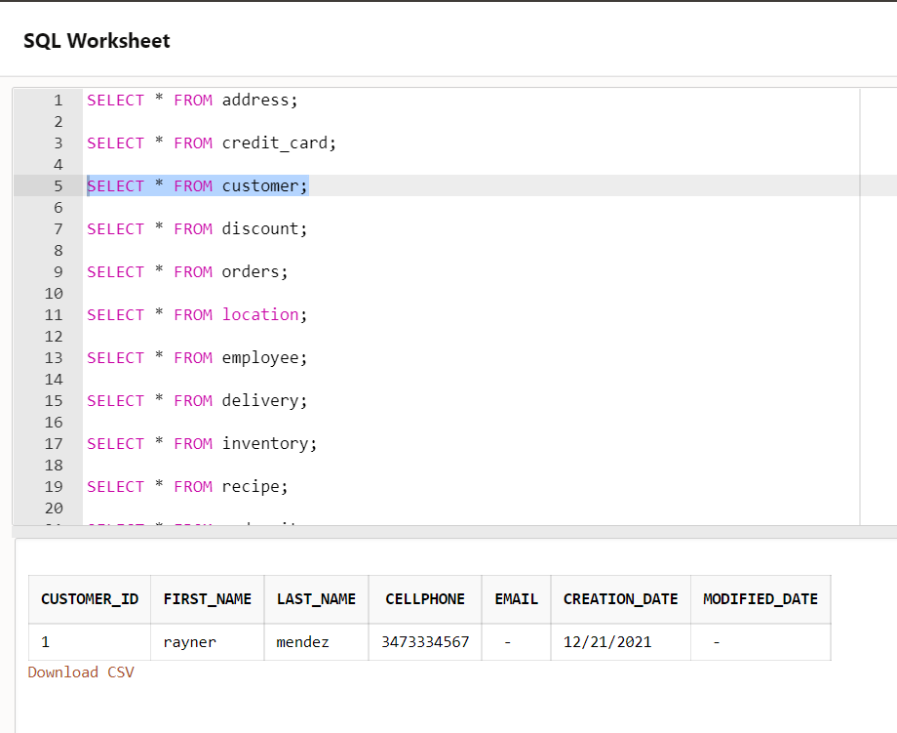
Testing 2

Slide 13
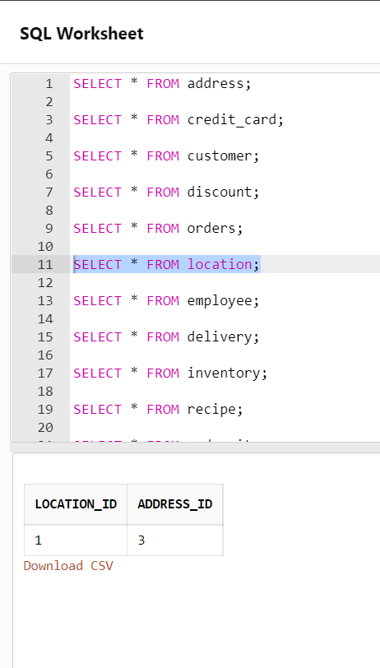
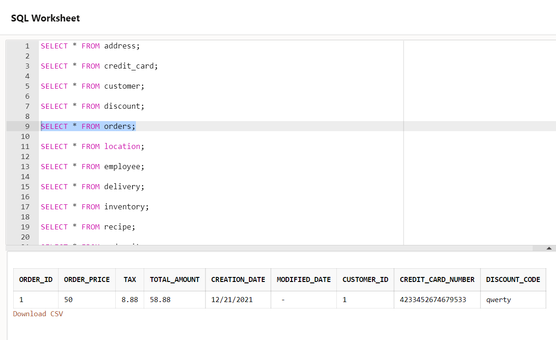
Testing 3

Slide 14
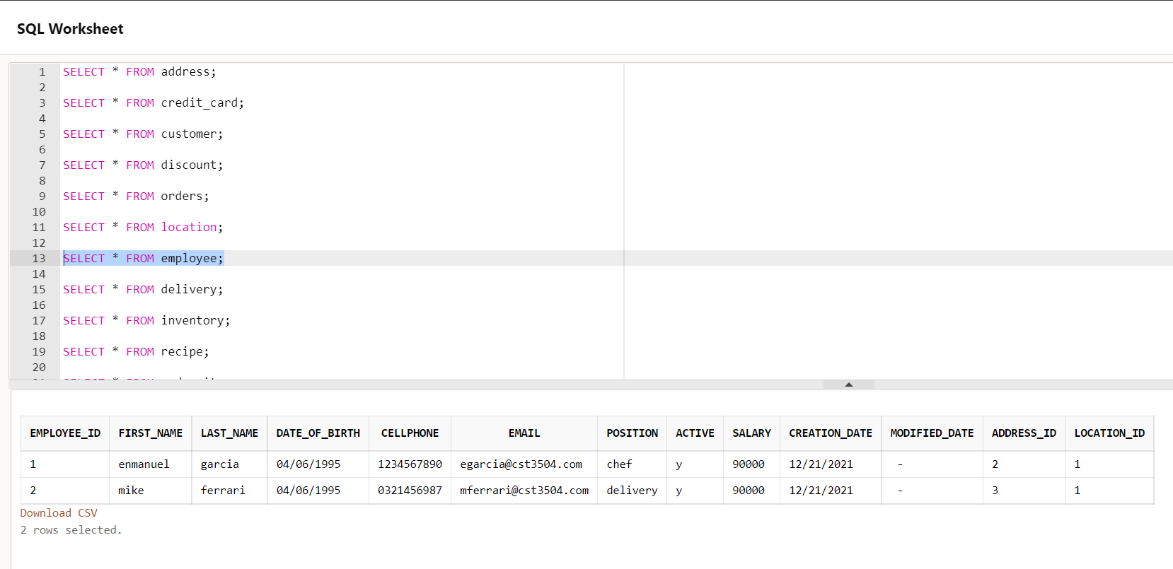
Testing 4

Slide 15
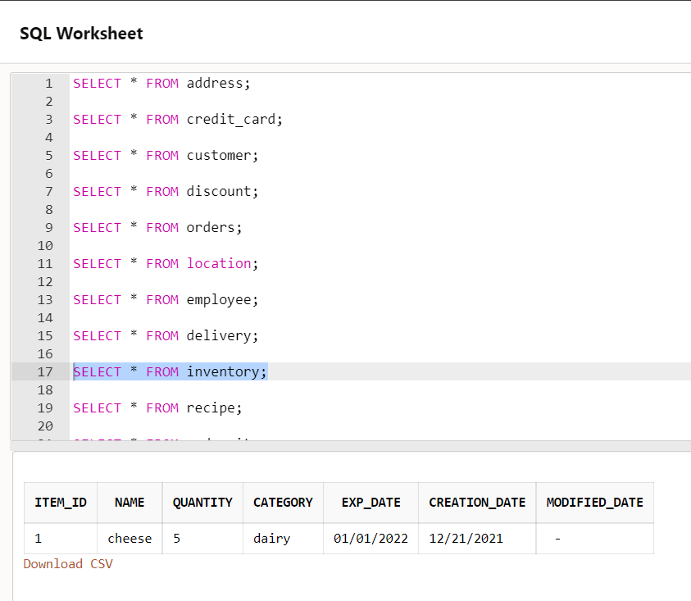
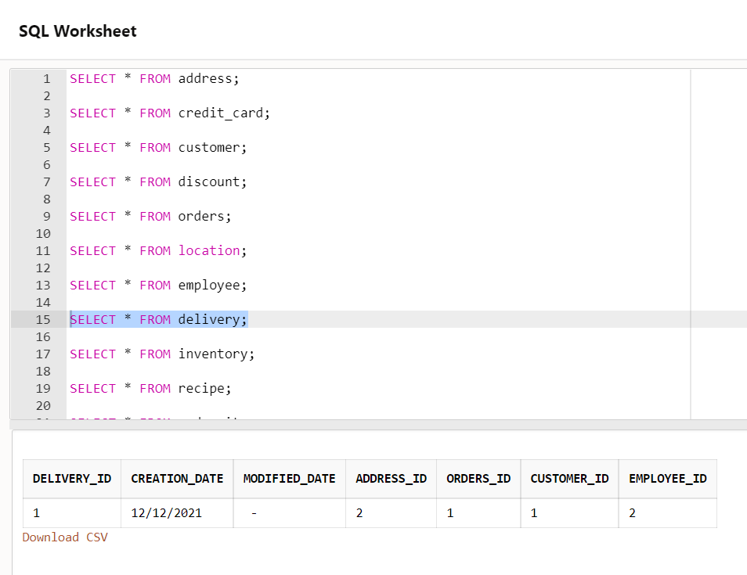
Testing 5

Slide 16
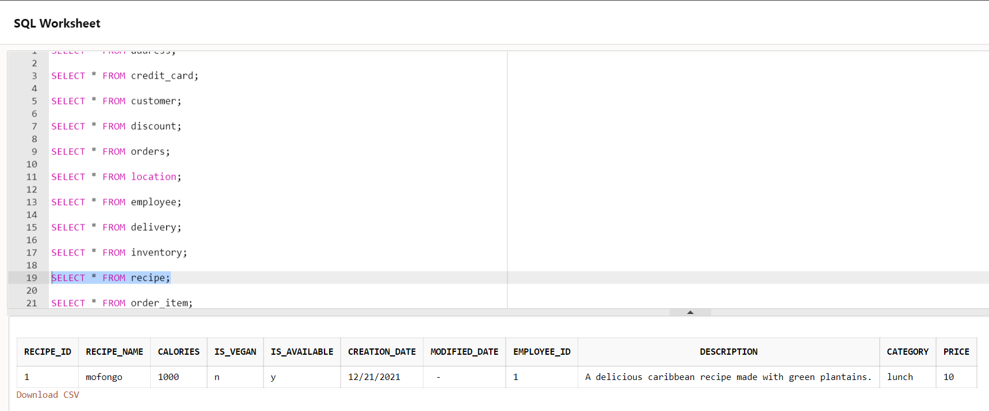
Testing 6

Slide 17
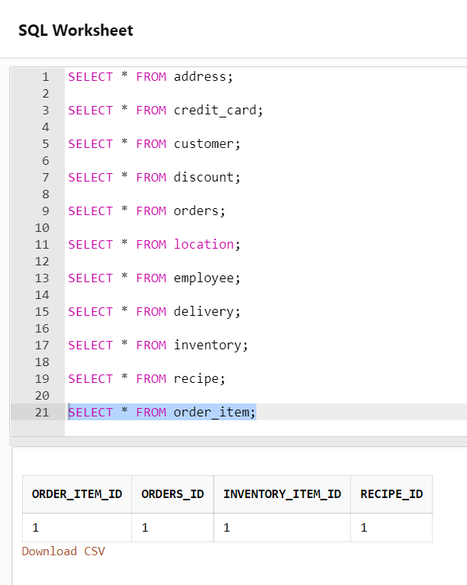
Testing 7
Click on the icon to open the script.sql file

Slide 18
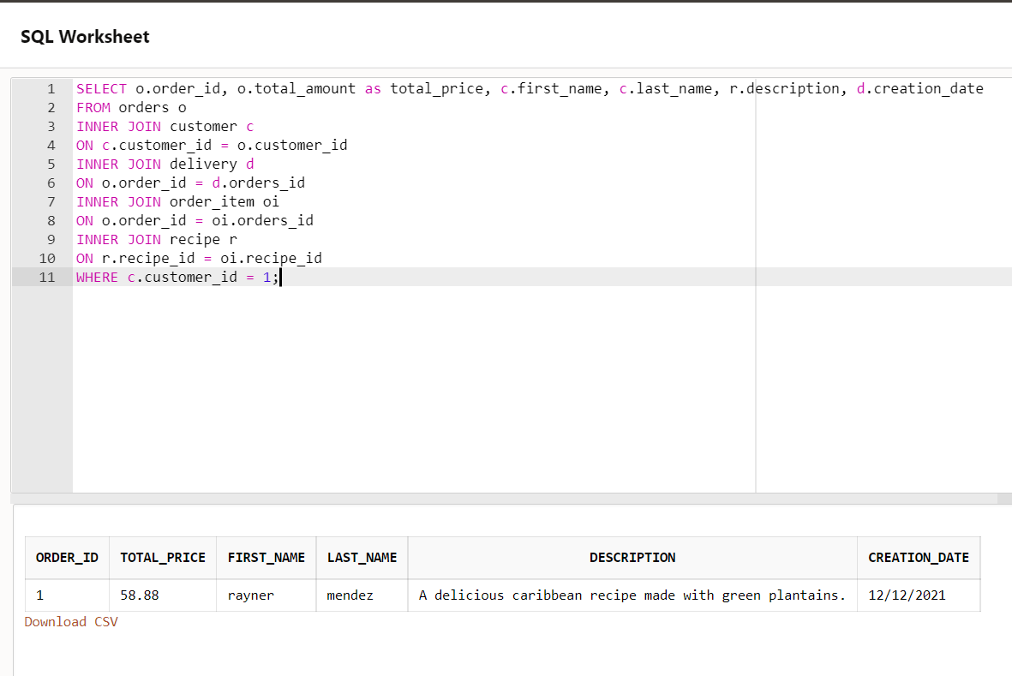
Testing 8

